Slide 1
Adventure Works
Where Every Day Is an Adventure!

Slide 2
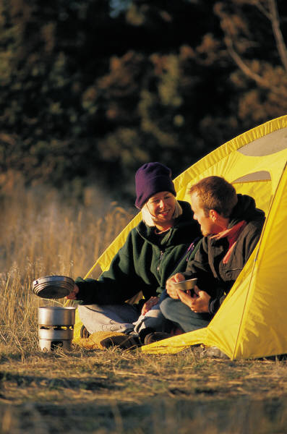
Our Programs
Outdoor day camps
Overnight camp-outs
Swimming
Hiking
Climbing
Rafting
Rappelling

Slide 3
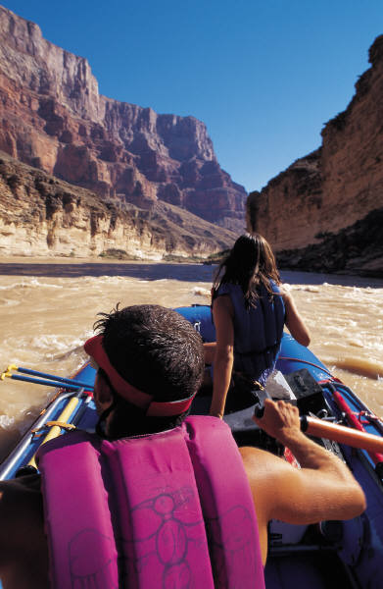
Our Students Learn
Basic water safety
Lifesaving
Outdoor safety
Boat handling
First aid
Direction-finding
Emergency management

Slide 4
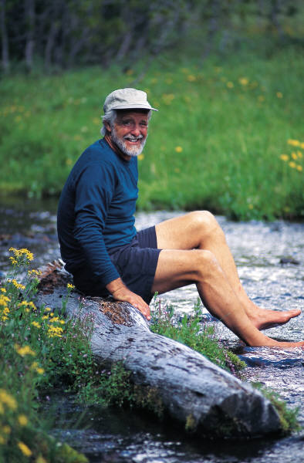
Our Instructors Are Certified in
Lifesaving
Water Safety
First Aid
Orienteering
Outdoor Survival
Team Building
Youth Counseling

Slide 5
Contact Us
Adventure Works
18 N. Elm Lane
Danville, KY 46033
800-555-0101
E-mail:
mike@adventureworks.com
On the Web:
www.adventureworks.com

